Slide 1

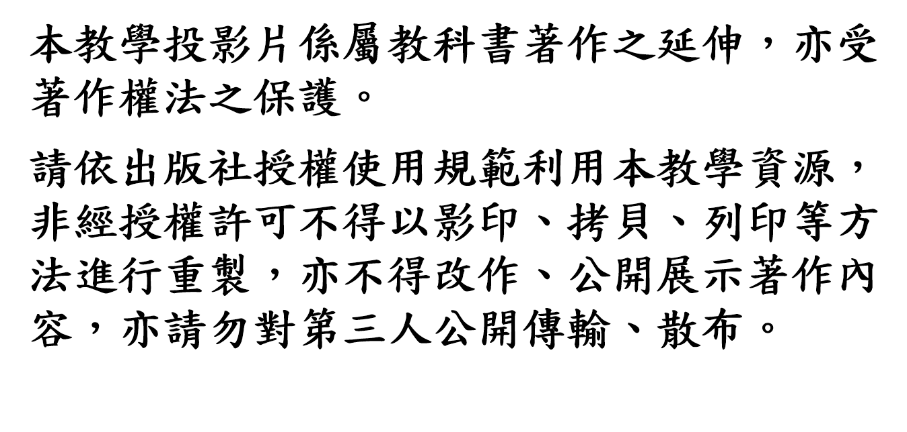

Slide 2
Registers and Counters
Chapter 6

Slide 3
Chapter Objectives
Understand the use, functionality, and modes of operation of registers, shift registers, and universal shift registers.
Know how to properly create the effect of a gated clock.
Understand the structure and functionality of a serial adder circuit.
Understand the behavior of a (a) ripple counter, (b) synchronous counter, (c)ring counter, and (d) Johnson counter.
Be able to write structural and behavioral HDL models of registers, shift registers, universal shift registers, and counters.

Slide 4
6.1 Registers
Clocked sequential circuits
a group of flip-flops and combinational gates
connected to form a feedback path
Flip-flops + Combinational gates
(essential) (optional)
Register:
a group of flip-flops
gates that determine how the information is transferred into the register
Counter:
a register that goes through a predetermined sequence of states

Slide 5
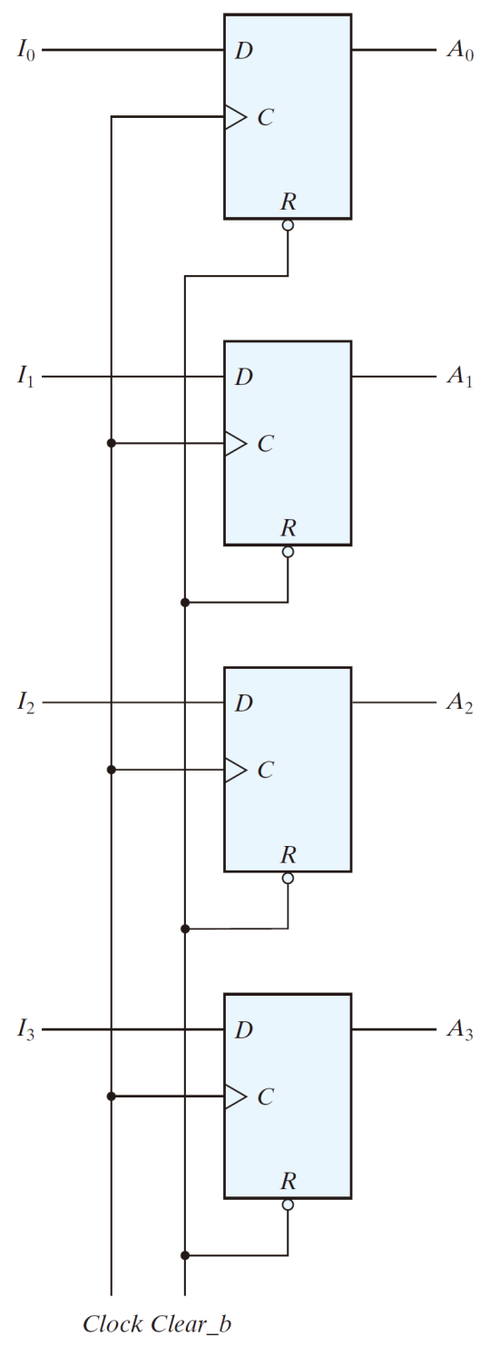
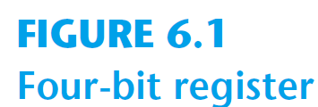
6.1 Registers
A n-bit register
n flip-flops capable of storing n bits of binary information
4-bit register

Slide 6
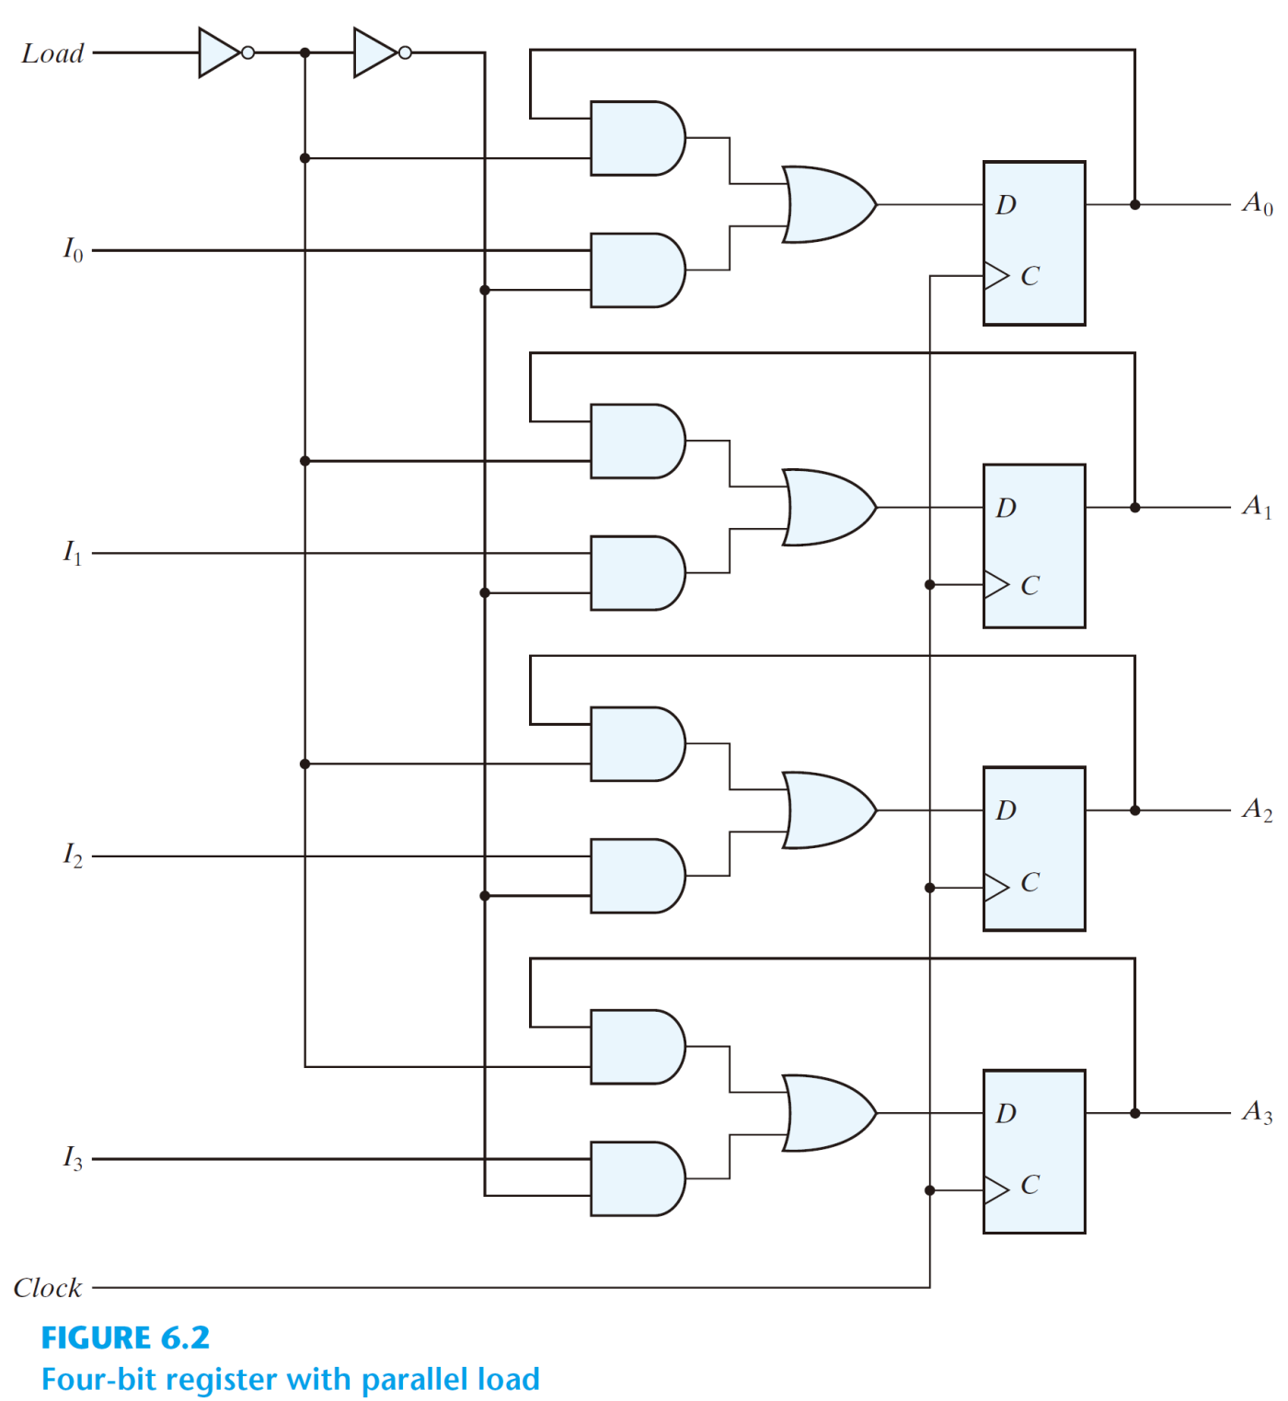
4-bit register with parallel load
load'
load

Slide 7
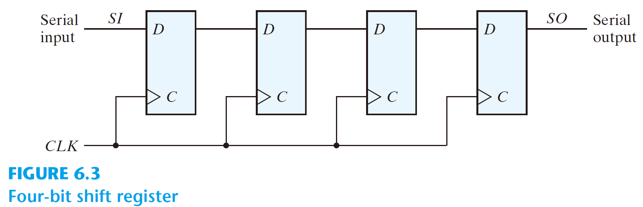
6.2 Shift Registers
Shift register
a register capable of shifting its binary information in one or both directions
Simplest shift register
1
0
1
1
0
1
1
0
1
1

Slide 8
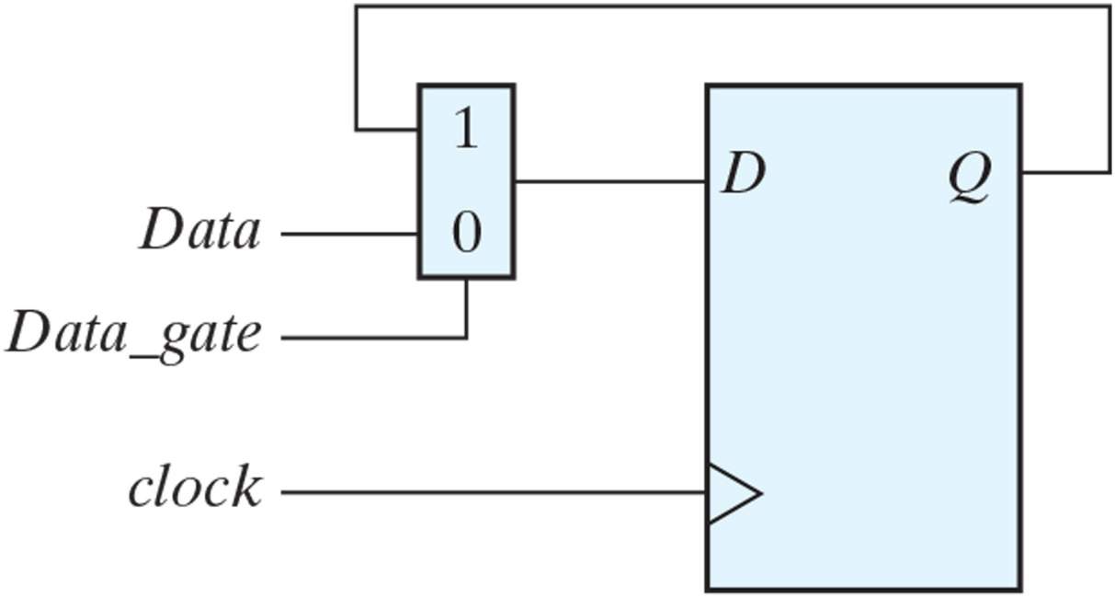
Practice Exercise
Practice Exercise 6.1
Objective: Draw the logic diagram of a circuit that suspends the clock action of a D flip-flop without gating its clock. Describe the behavior of the circuit.
Answer:
If Data_gate is 0, Data is transferred to Q with each active edge of clock. If Data_gate is 1, the value of Q is recirculated through the mux-flip-flop path, with the effect that clock appears to be suspended.
Figure PE6.1

Slide 9
Serial transfer
Serial transfer
Information is transferred one bit at a time
shifts the bits out of the source register into the destination register
Parallel transfer:
All the bits of the register are transferred at the same time

Slide 10
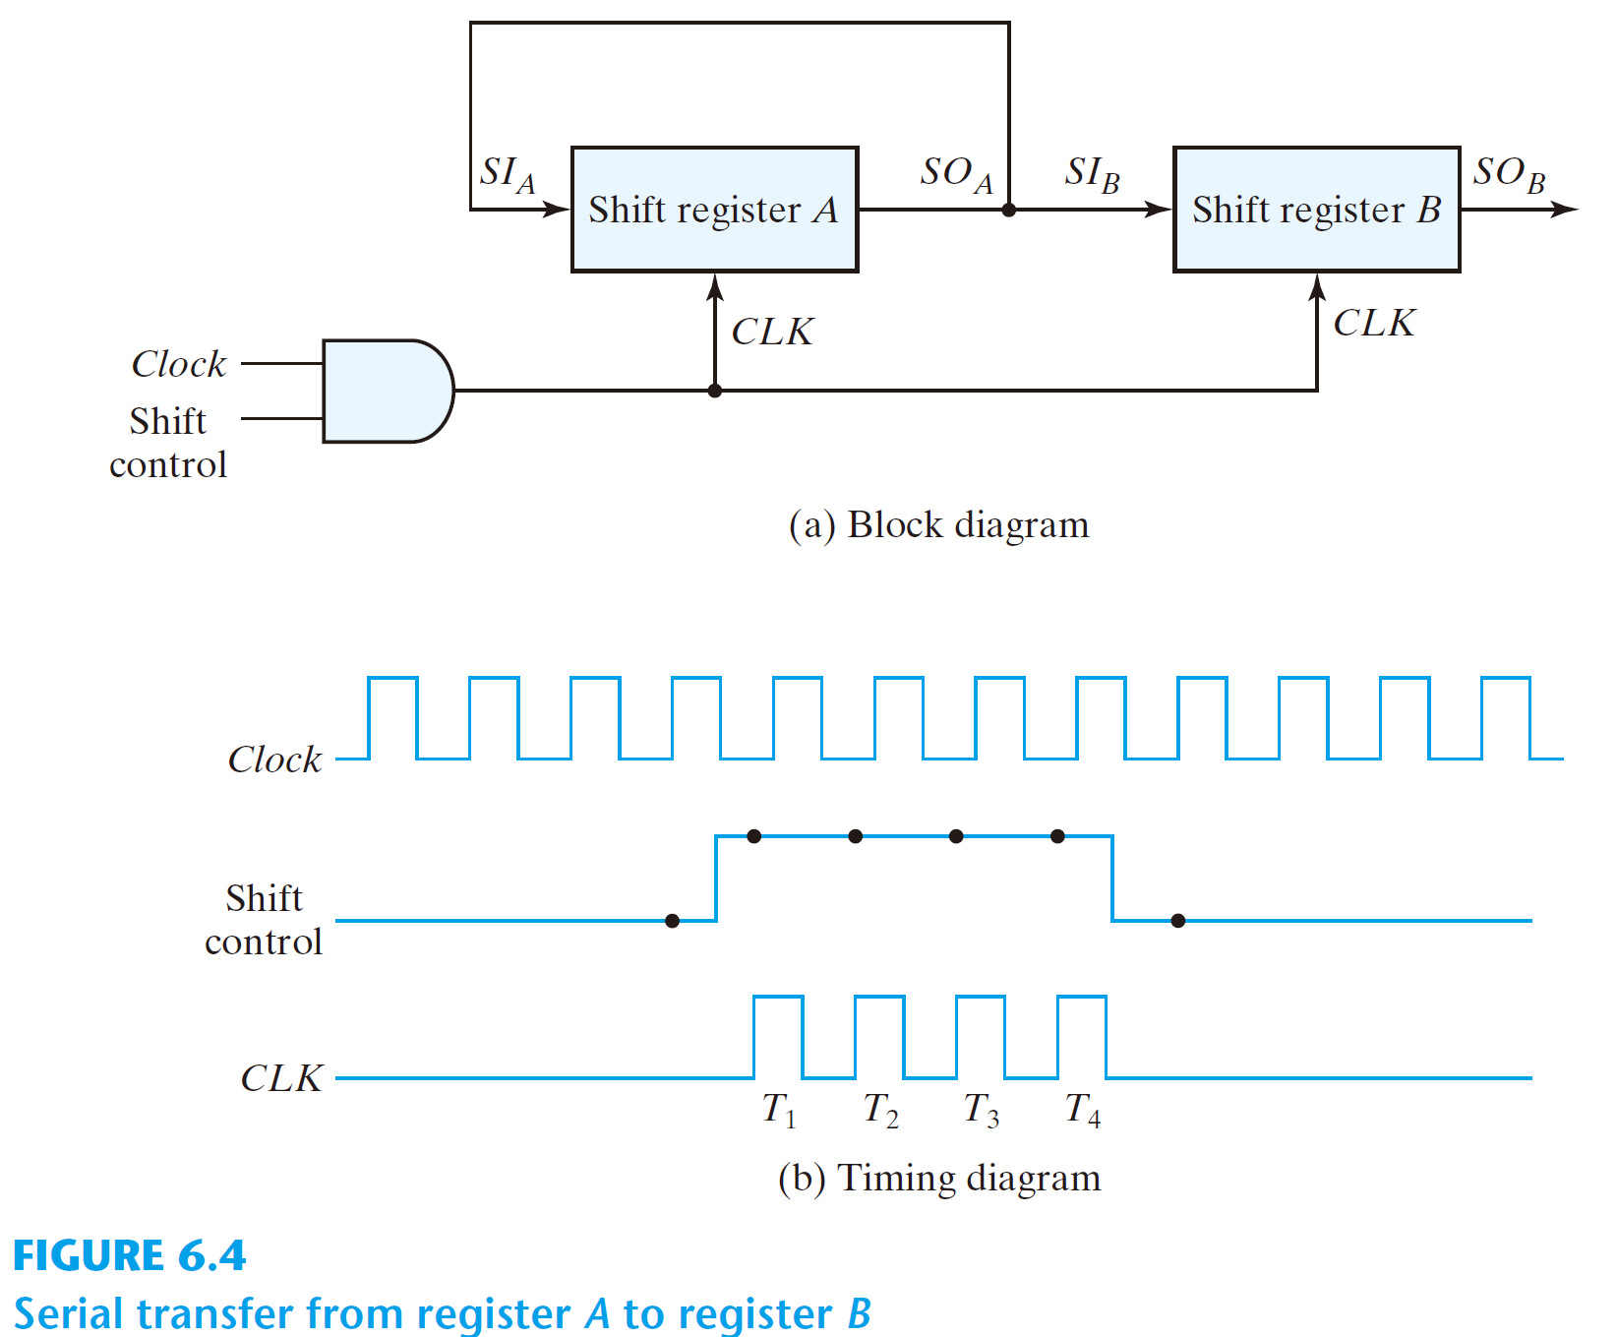
Example: Serial transfer from reg A to reg B

Slide 11
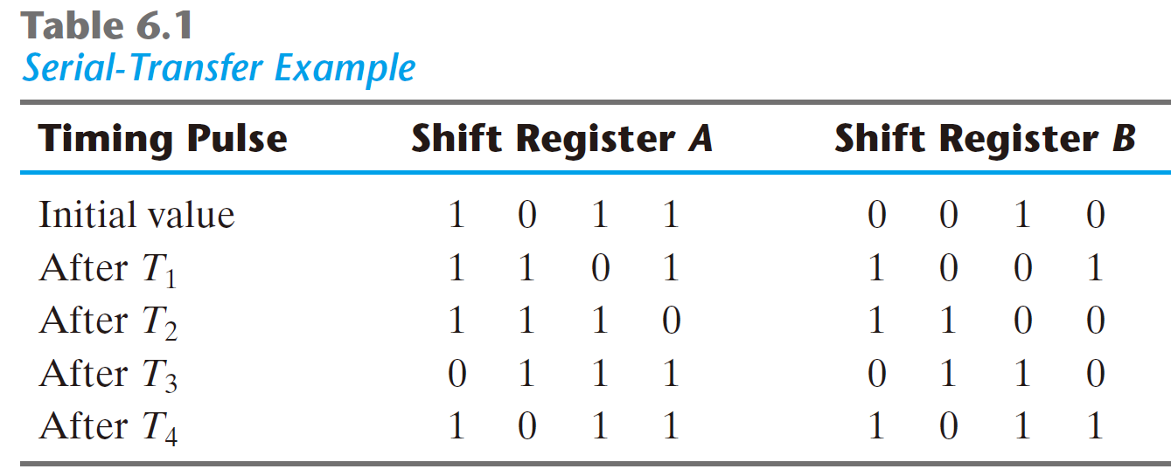
Example: Serial transfer from reg A to reg B

Slide 12
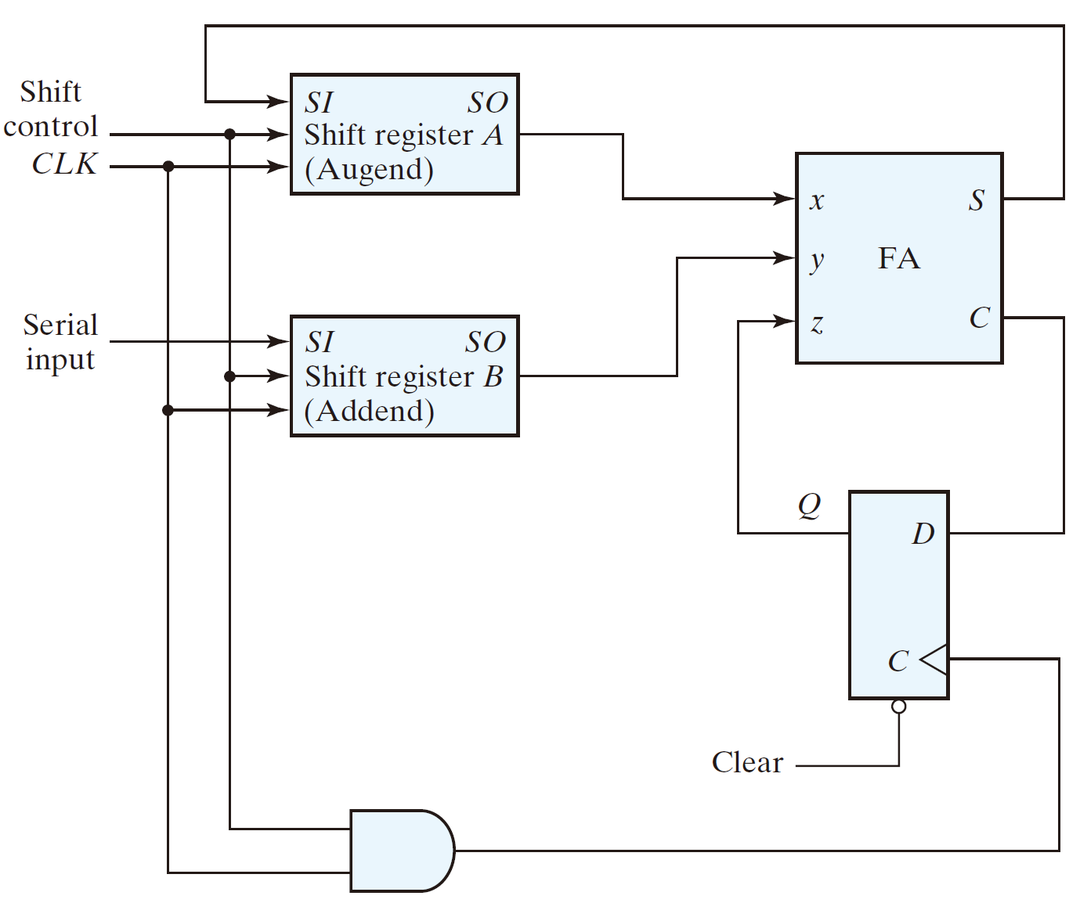
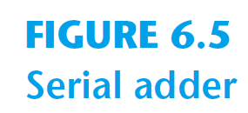
Serial addition using D flip-flops
1
0
0101
0
0
1010
1
1
0
1
1
1
0011
?001

Slide 13
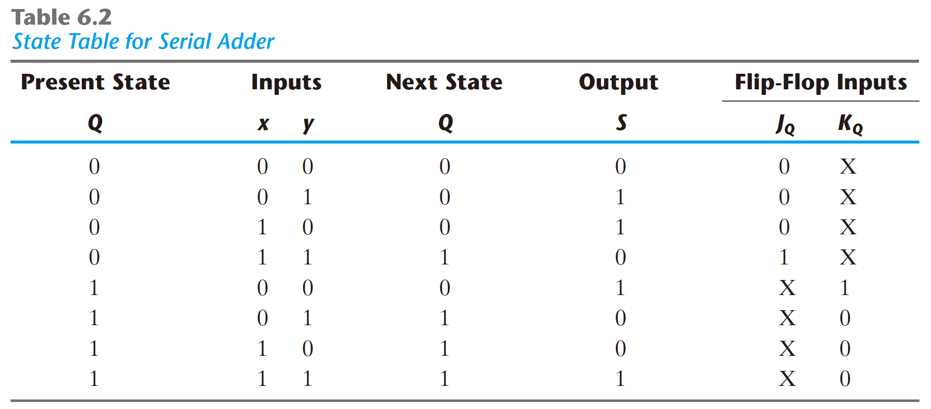
Serial adder using JK flip-flops
J_{Q} = x y
K_{Q} = x′ y′ = (x + y)′
S = x ⊕ y ⊕ Q

Slide 14
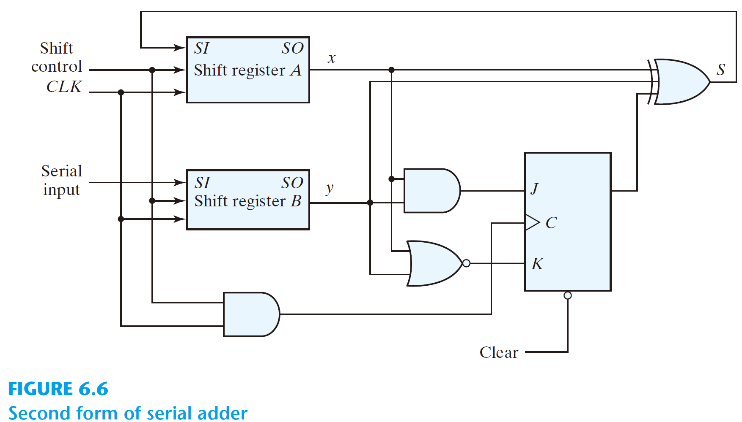
Circuit diagram
J_{Q} = x y
K_{Q} = x′ y′ = (x + y)′
S = x ⊕ y ⊕ Q
C_{i}

Slide 15
Practice Exercise
Practice Exercise 6.2
Explain why a serial adder is a sequential circuit.
Answer: The circuit uses a flip-flop.

Slide 16
Universal Shift Register
Unidirectional shift register
Bidirectional shift register
Universal shift register:
has both direction shifts & parallel load/out capabilities

Slide 17
Capability of a universal shift register:
A clear control to clear the register to 0.
A clock input to synchronize the operations.
A shift-right control to enable the shift right operation and the serial input and output lines associated w/ the shift right.
A shift-left control to enable the shift left operation and the serial input and output lines associated w/ the shift left.
A parallel-load control to enable a parallel transfer and the n parallel input lines associated w/ the parallel transfer.
n parallel output lines.
A control state that leaves the information in the register unchanged in the presence of the clock.

Slide 18
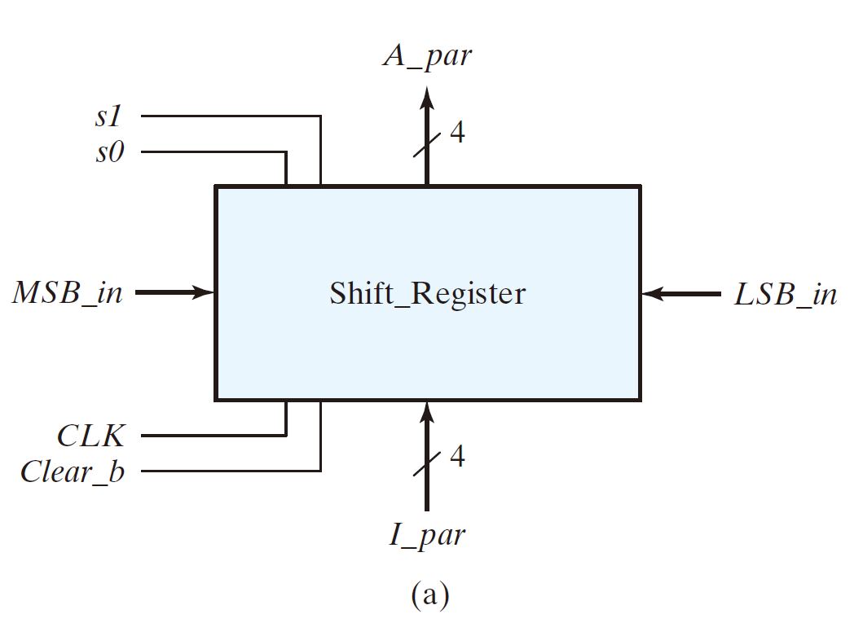

Example: 4-bit universal shift register

Slide 19
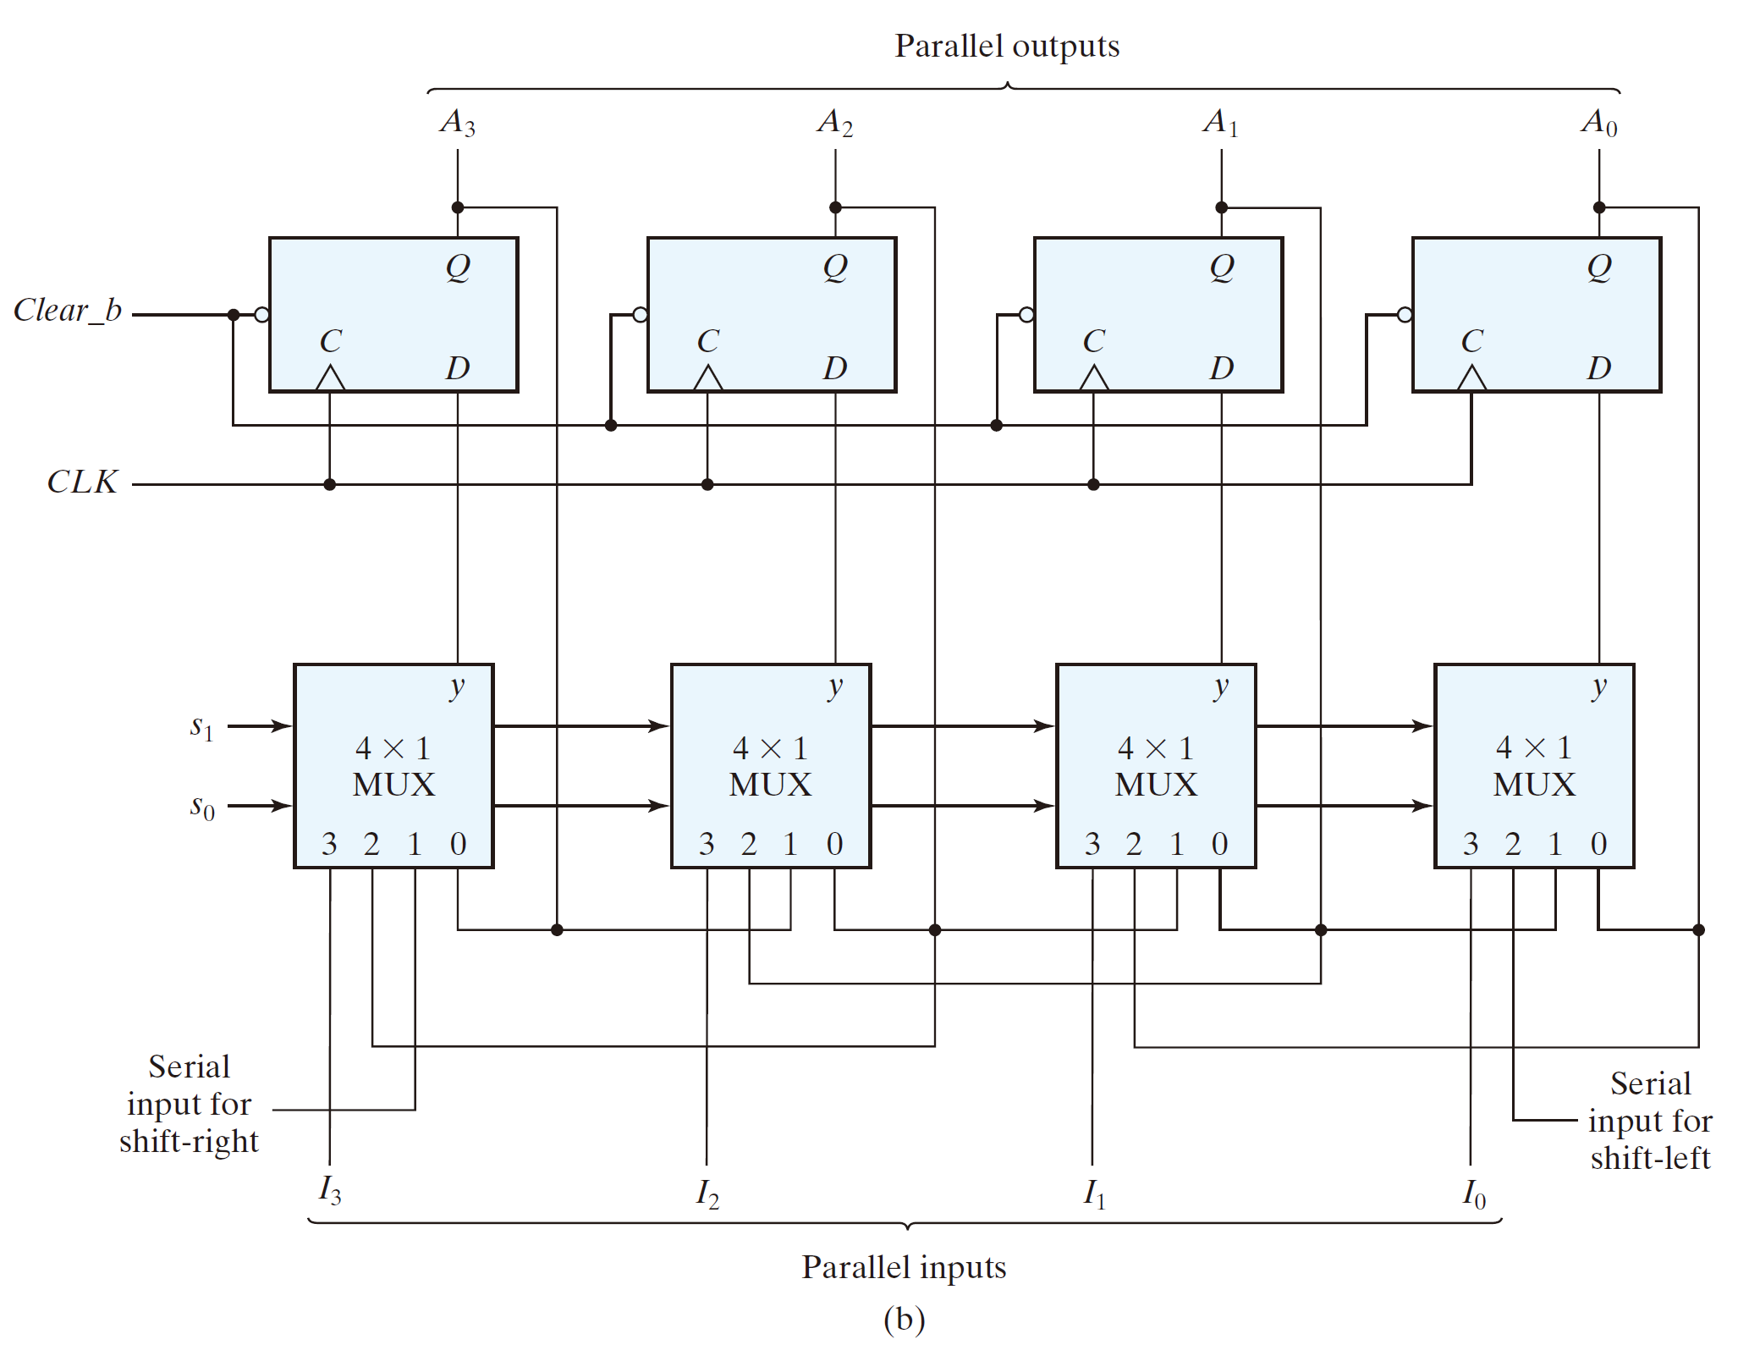
A₀
A₁
A₂

Slide 20
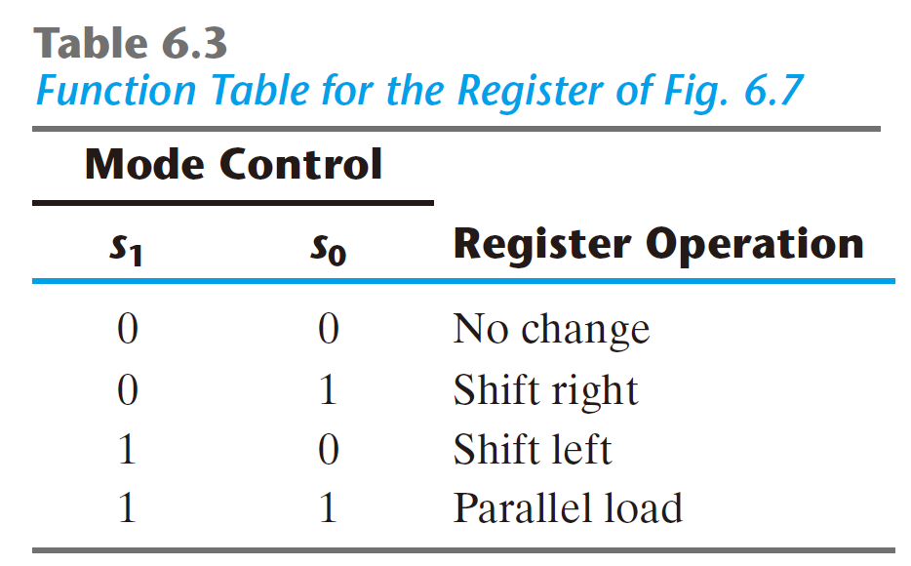
♣ Function Table

Slide 21
6.3 Ripple Counters
Counter:
a register that goes through a prescribed sequence of states
upon the application of input pulses
Input pulses: may be clock pulses or
originate from some external source
The sequence of states: may follow the binary number sequence (⇒ Binary counter) or
any other sequence of states

Slide 22
Categories of counters
Ripple counters
The flip-flop output transition serves as a source for triggering other flip-flops
⇒ no common clock pulse (not synchronous)
Synchronous counters:
The CLK inputs of all flip-flops receive a common clock

Slide 23
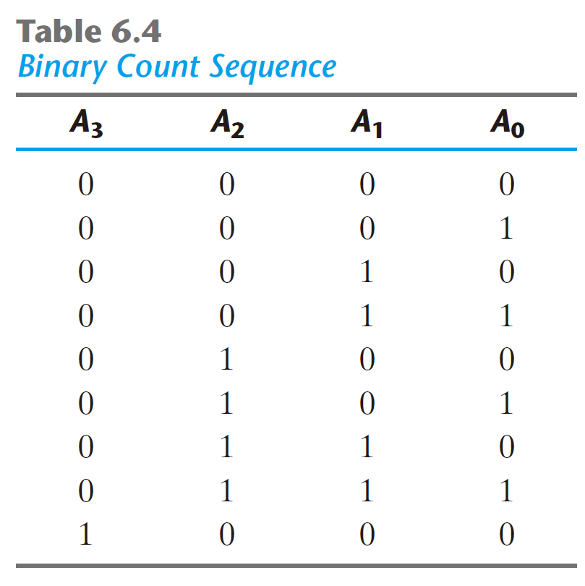
Example: 4-bit binary ripple counter
Binary count sequence: 4-bit

Slide 24
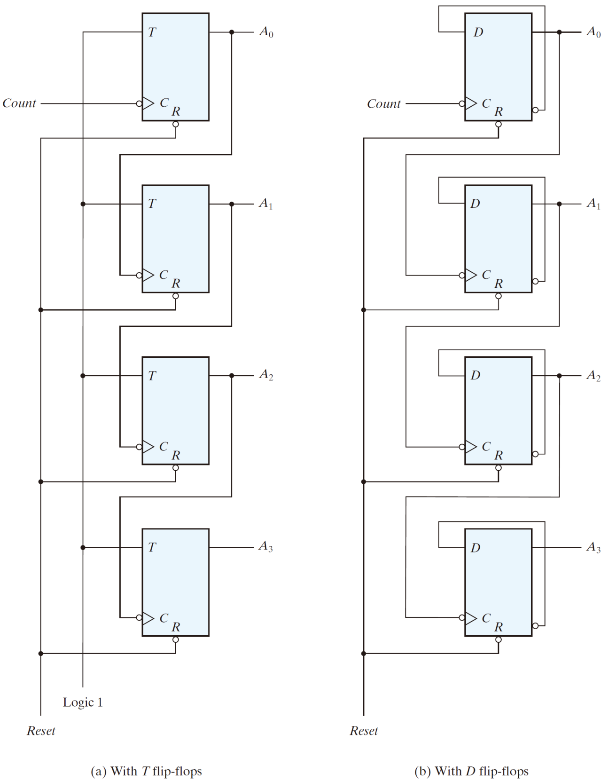

1↓0
↓
1↓0

Slide 25
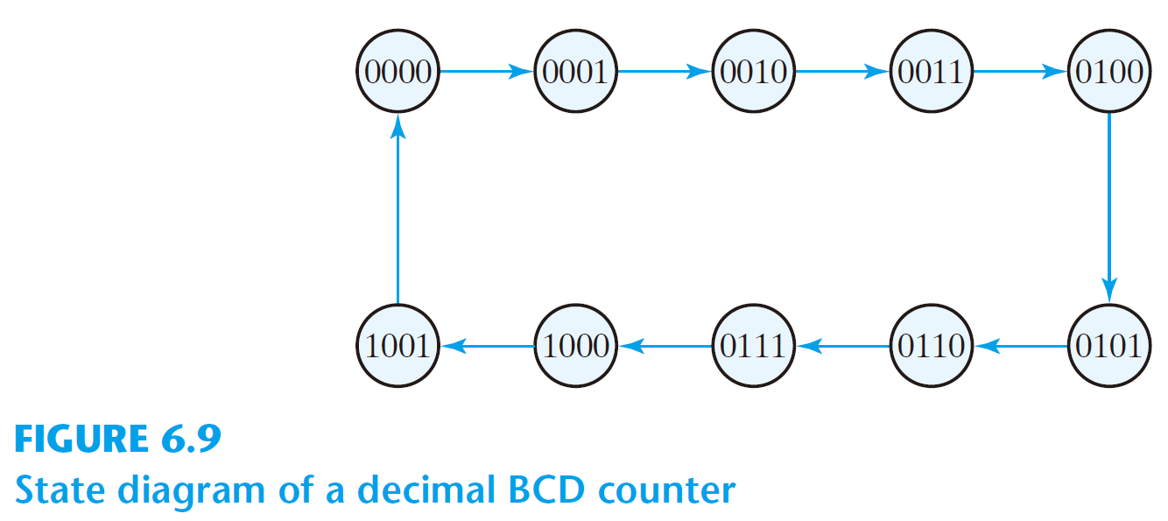
BCD ripple counter

Slide 26
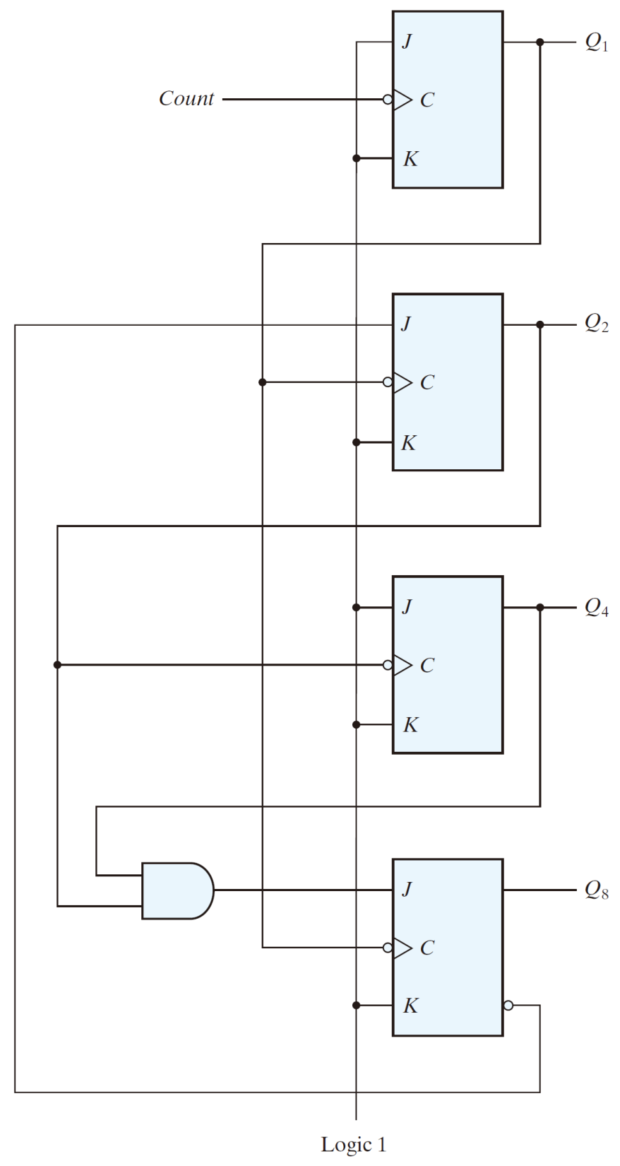

The circuit

Slide 27
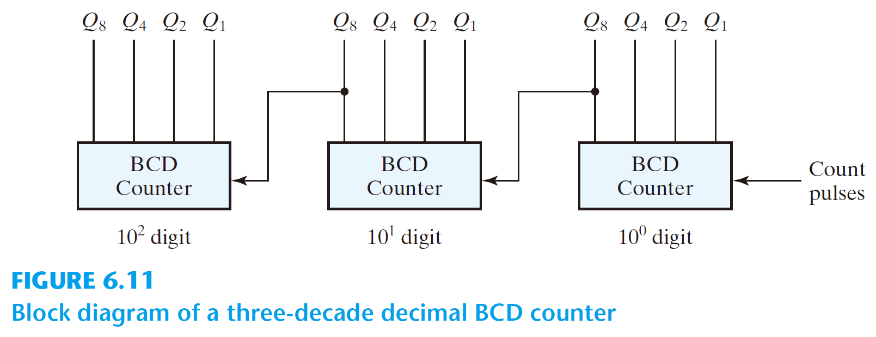
Three-decade BCD counter

Slide 28
6.4 Synchronous Counters
Sync counter
A common clock triggers all flip-flops simultaneously
Design procedure
apply the same procedure of sync seq ckts
Sync counter is simpler than general sync seq ckts

Slide 29
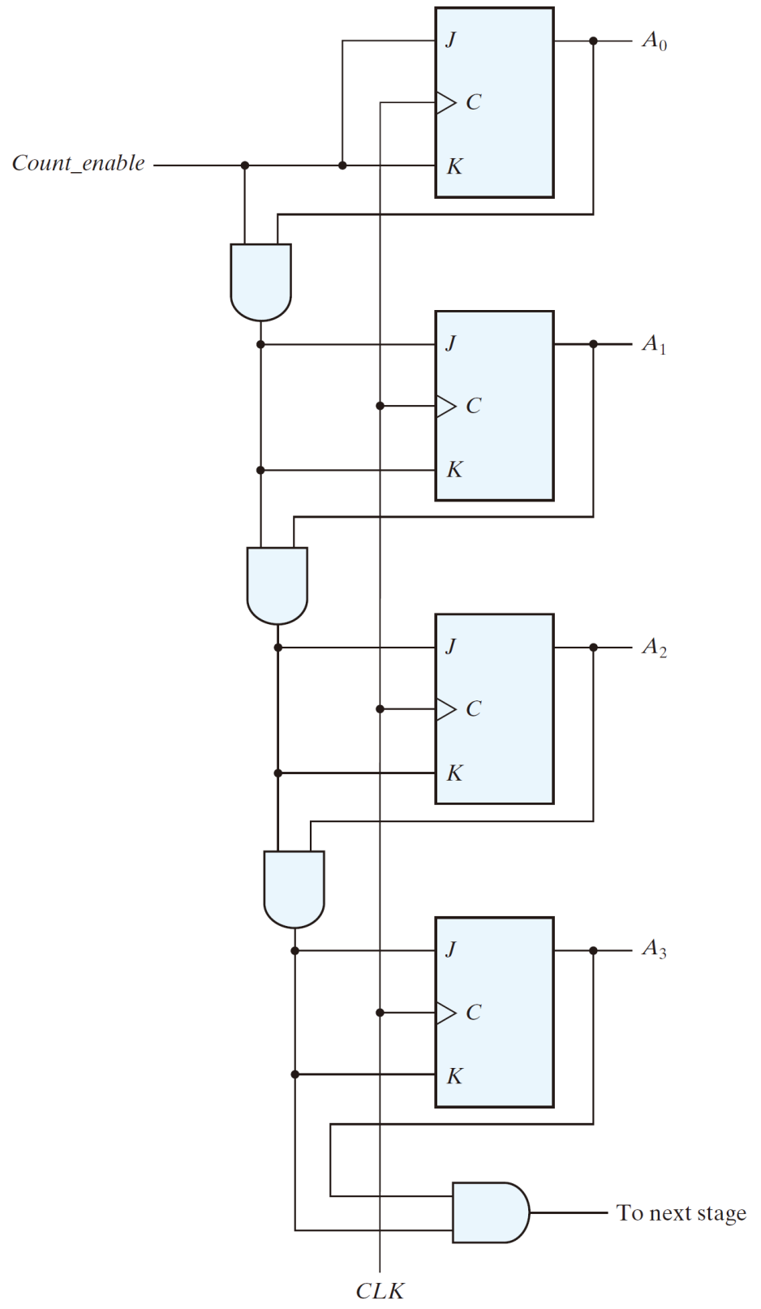

4-bit binary counter
C_en A₀
C_en A₀ A₁
C_en A₀ A₁ A₂

Slide 30
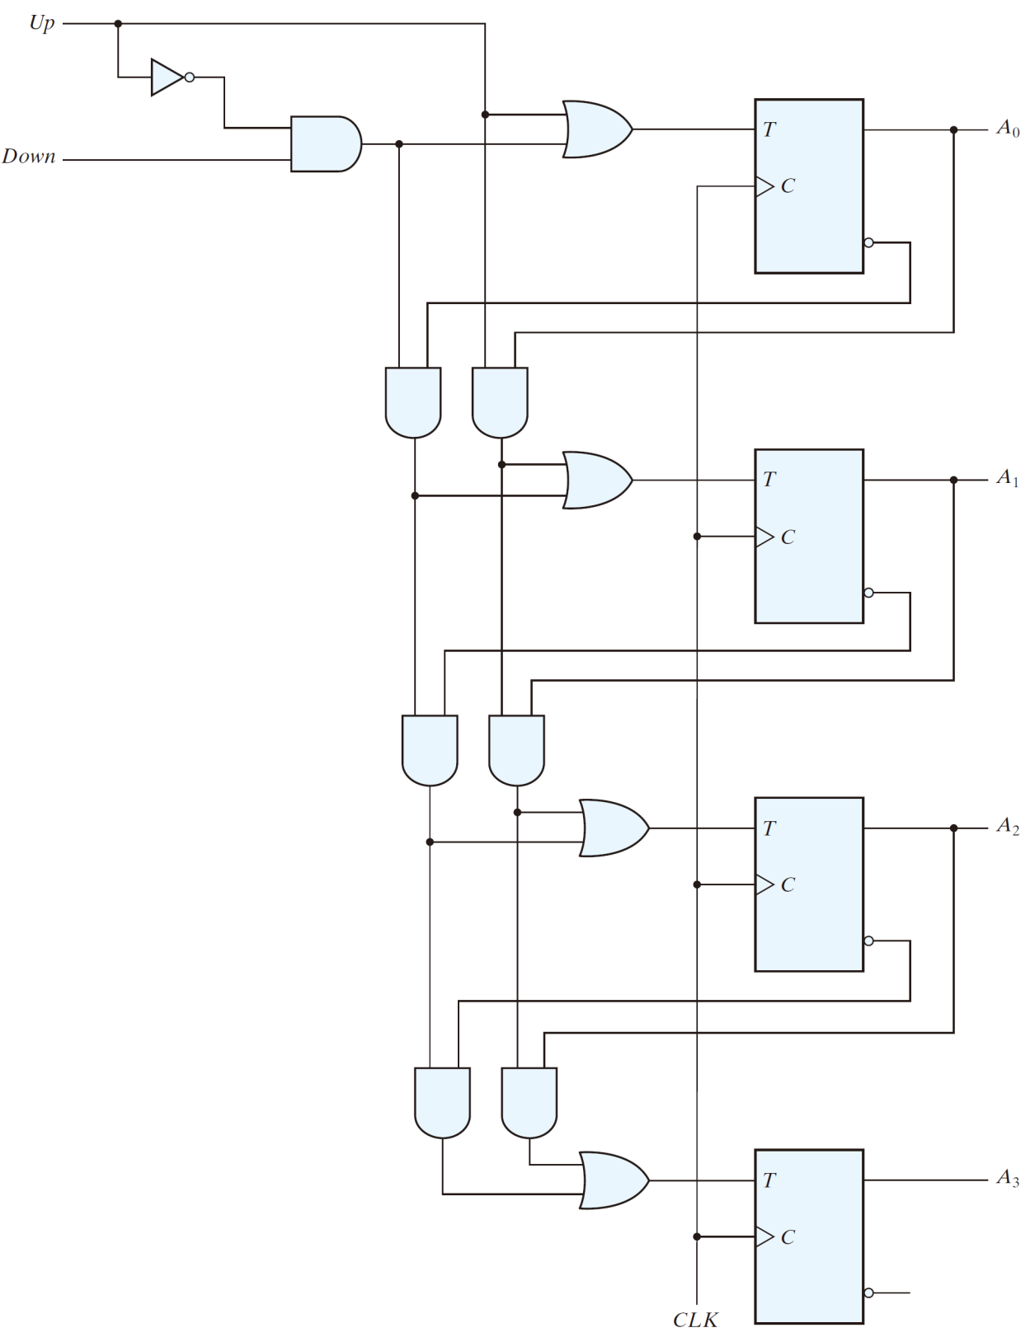

up
4-bit up/down binary counter
down
up A₀
down A'₀
down A'₀ A'₁
up A₀ A₁
down A'₀ A'₁ A'₂

Slide 31
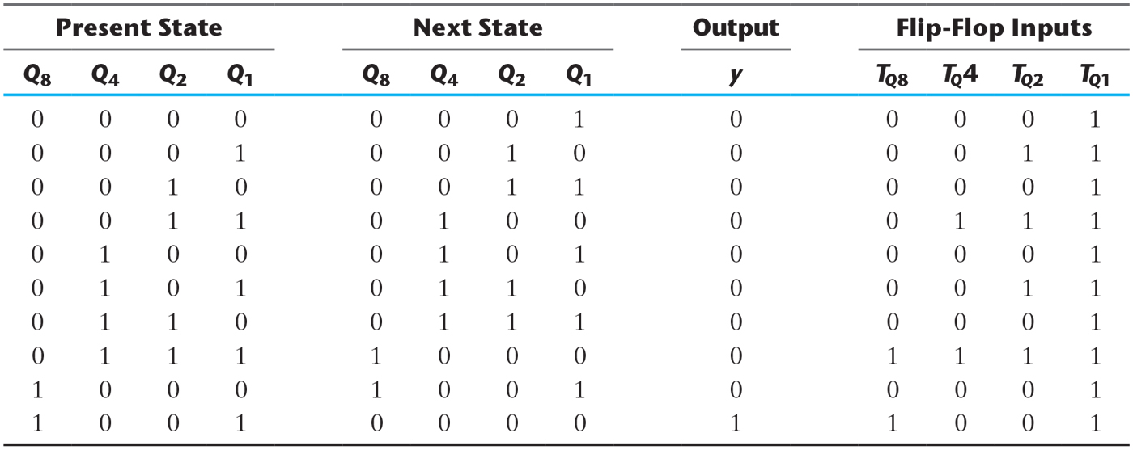
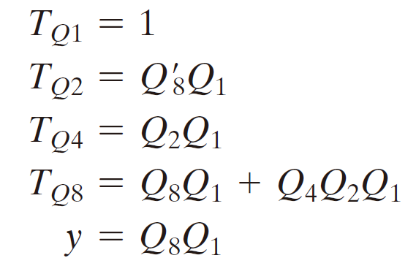
BCD counters
Table 6.5 State Table for BCD Counter.
♣ Simplified functions:

Slide 32
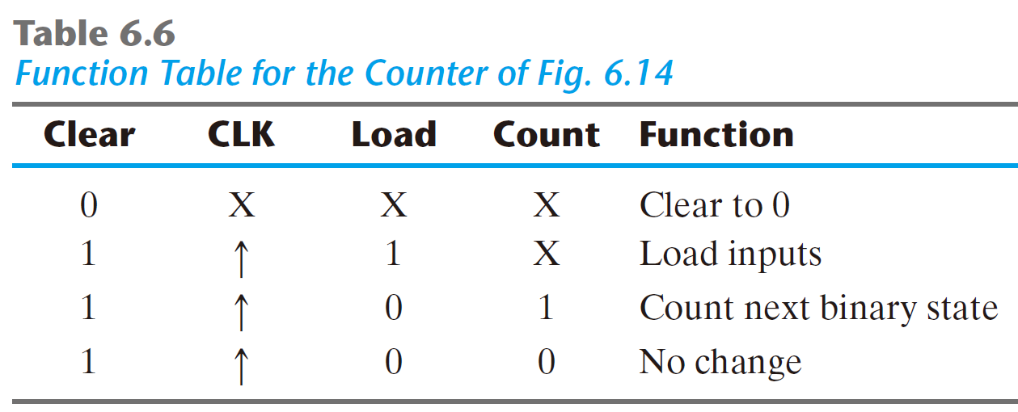
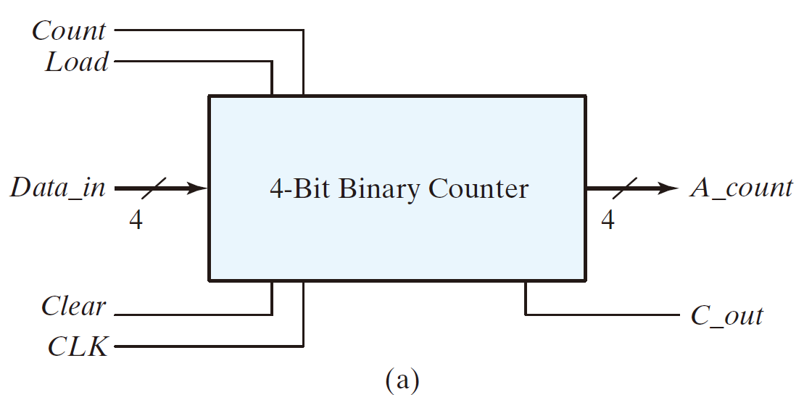
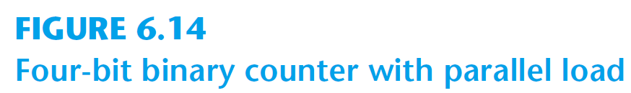
4-bit binary counter w/ parallel load

Slide 33
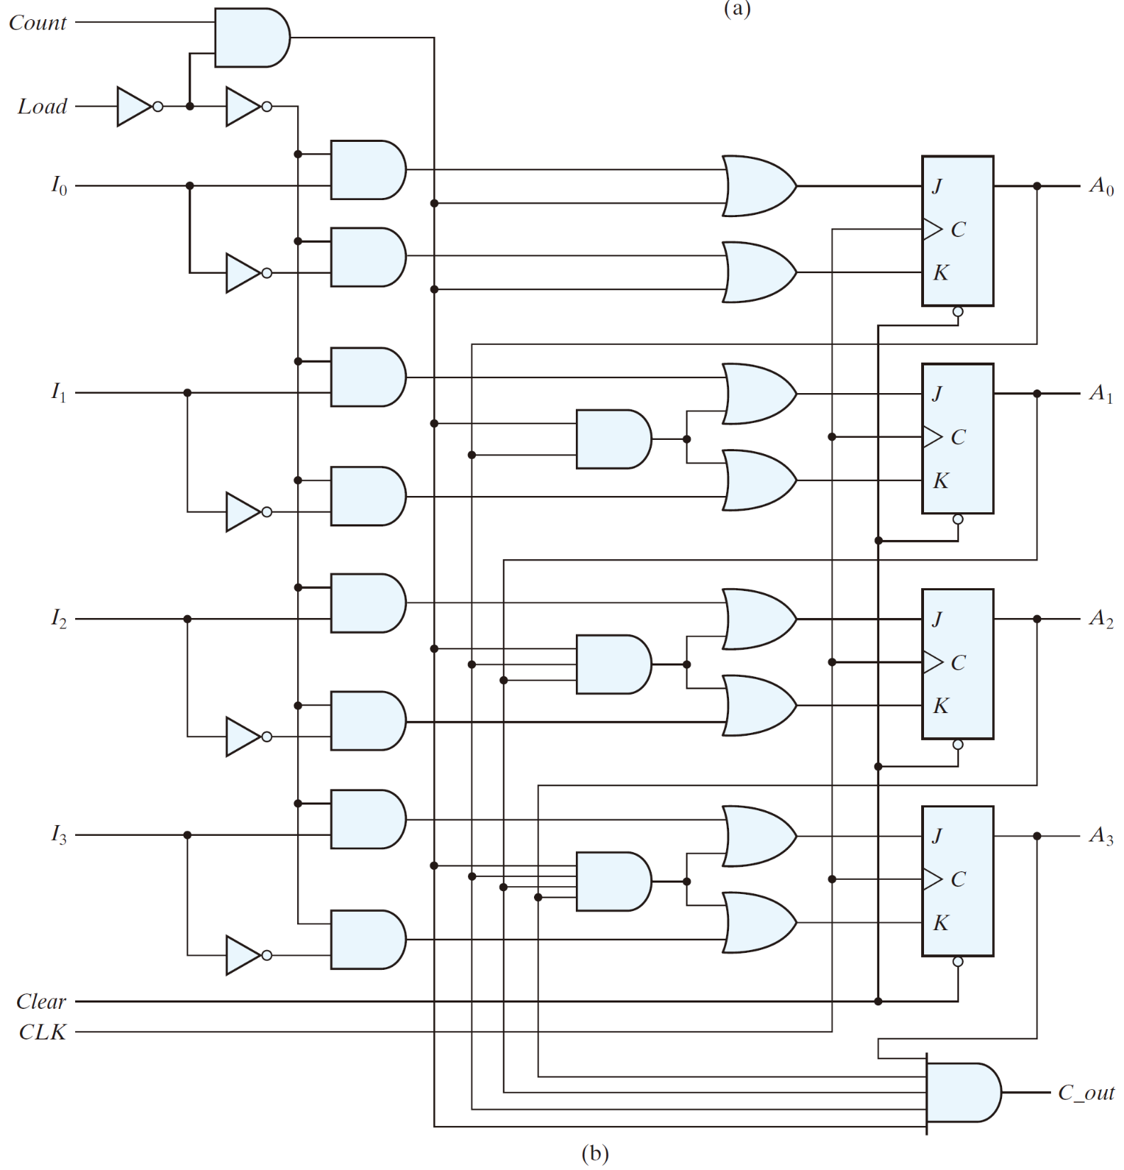
load
count load'
c_en
c_en A₀
async

Slide 34
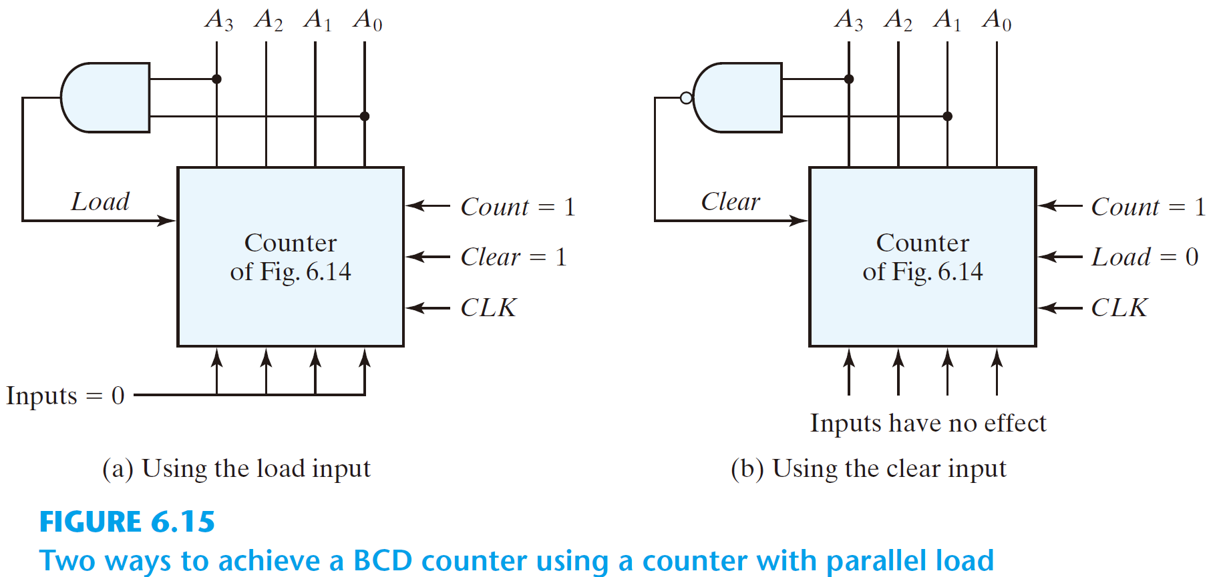
Generate any count sequence
E.g.: BCD counter ⇐ Counter w/ parallel load

Slide 35
Practice Exercise
Practice Exercise 6.3
How do a ripple counter and a synchronous counter differ in their behavior?
Answer: All of the flip-flops in a synchronous counter are synchronized by receiving a common clock pulse; only the first stage of a ripple counter receives a clock pulse. The stages of a synchronous counter are updated simultaneous by a common clock; the stages of a ripple counter are updated one at a time. A synchronous counter operates faster than a ripple counter.

Slide 36
6.5 Other Counters
Counters:
can be designed to generate any desired sequence of states
Divide-by-N counter (modulo-N counter)
a counter that goes through a repeated sequence of N states
The sequence may follow the binary count or may be any other arbitrary sequence

Slide 37
n flip-flops ⇒ 2^{n} binary states
Unused states
states that are not used in specifying the FSM
may be treated as don’t-care conditions or
may be assigned specific next states
Self-correcting counter
Ensure that when a ckt enter one of its unused states, it eventually goes into one of the valid states after one or more clock pulses so it can resume normal operation.
⇒ Analyze the ckt to determine the next state from an
unused state after it is designed

Slide 38
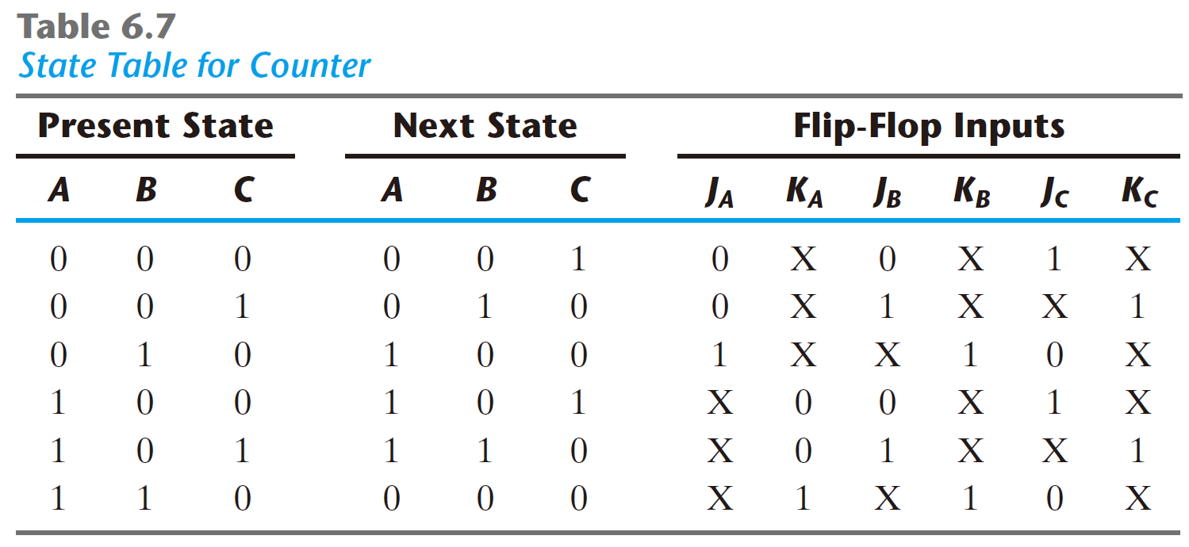
An example
Two unused states: 011 & 111
The simplified flip-flop input eqs:
J_{A} = B, K_{A} = B
J_{B} = C, K_{B} = 1
J_{C} = B′, K_{C} = 1

Slide 39
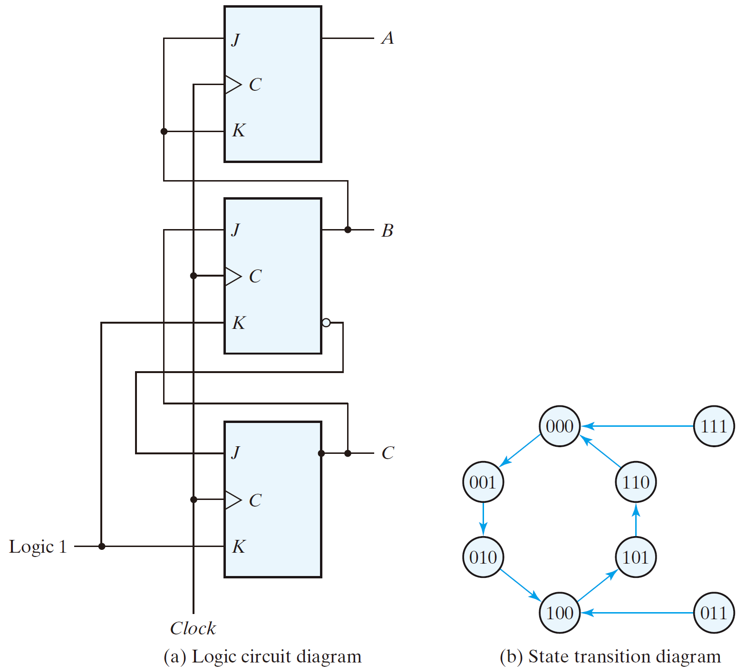

The logic diagram & state diagram of the ckt
The simplified flip-flop input eqs:
J_{A} = B, K_{A} = B
J_{B} = C, K_{B} = 1
J_{C} = B′, K_{C} = 1

Slide 40
Ring counter:
a circular shift register w/ only one flip-flop being set at any particular time, all others are cleared
(initial value = 1 0 0 … 0 )
The single bit is shifted from one flip-flop to the next to produce the sequence of timing signals.

Slide 41
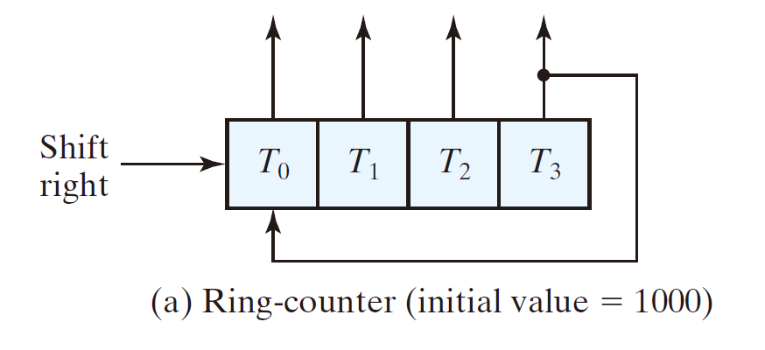

A 4-bit ring counter
A₂ A₂ A₁ A₀
1 0 0 0
0 1 0 0
0 0 1 0
0 0 0 1
1 0 0 0

Slide 42
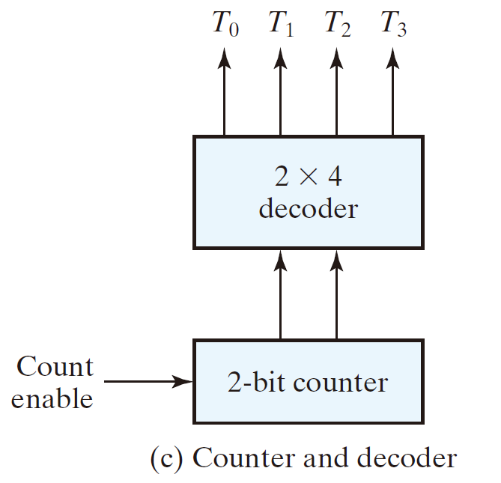
Application of counters
Counters may be used to generate timing signals to control the sequence of operations in a digital system.
Approaches for generation of 2^{n} timing signals
1. a shift register w/ 2^{n} flip-flops
2. an n-bit binary counter together w/ an n-to-2^{n}-line decoder

Slide 43
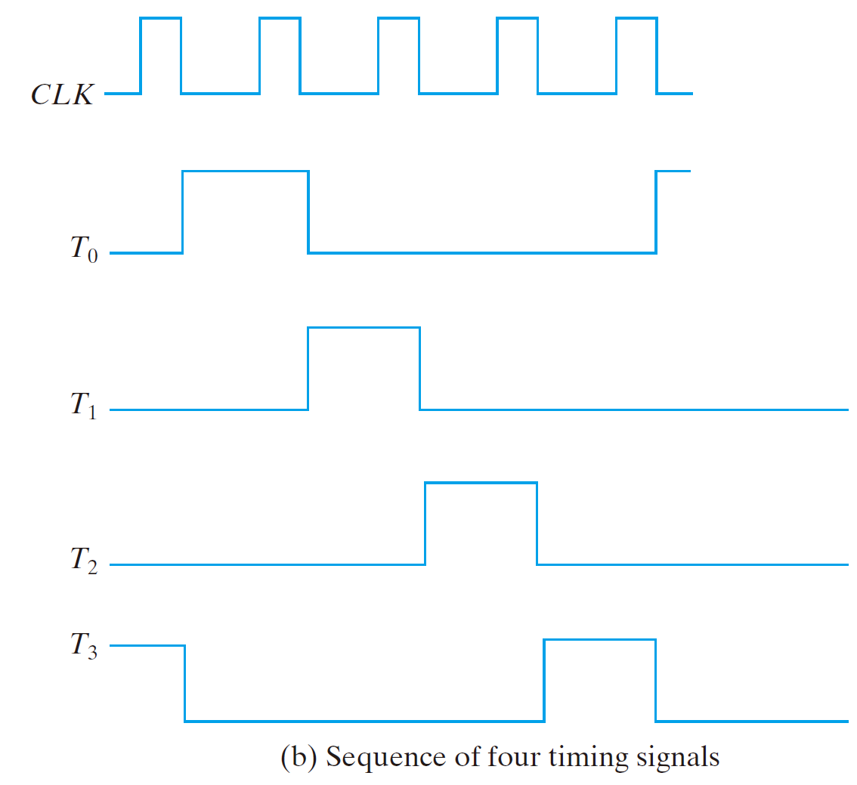

Slide 44
Johnson counter
Ring counter vs. Switch-tail ring counter
Ring counter
a k-bit ring counter circulates a single bit among the flip-flops to provide k distinguishable states.
Switch-tail ring counter
is a circular shift register w/ the complement output of the last flip-flop connected to the input of the first flip-flop
a k-bit switch-tail ring counter will go through a sequence of 2k distinguishable states. (initial value = 0 0 … 0)

Slide 45
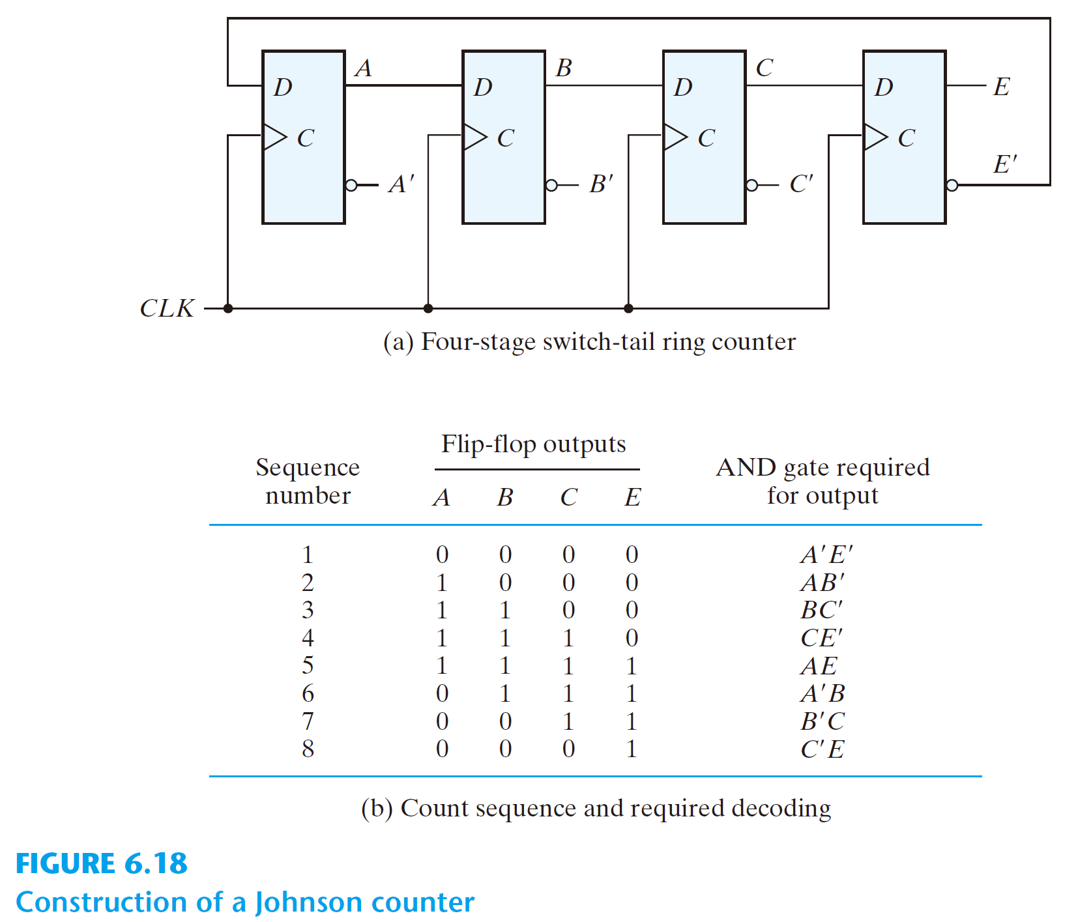
An example: Switch-tail ring counter

Slide 46
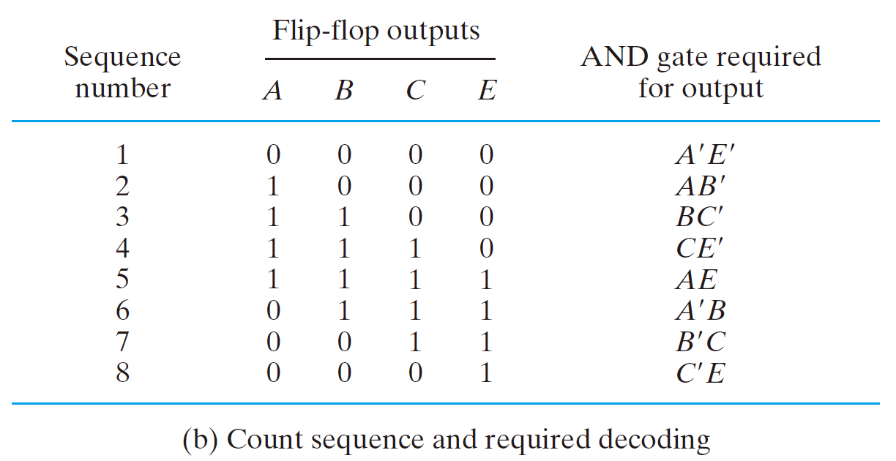
Johnson counter
a k-bit switch-tail ring counter + 2k decoding gates
provide outputs for 2k timing signals
E.g.: 4-bit Johnson counter
The decoding follows a regular pattern:
2 inputs per decoding gate

Slide 47
Disadv. of the switch-tail ring counter
if it finds itself in an unused state, it will persist to circulate in the invalid states and never find its way to a valid state.
One correcting procedure: D_{C} = (A + C) B
Summary:
Johnson counters can be constructed for any # of timing sequences:
# of flip-flops = 1/2 (the # of timing signals)
# of decoding gates = # of timing signals
2-input per gate

Slide 48
6.6 HDL for Registers and Counters
♣ Shift Register
Statement:
A_par <= {MSB_in, A_par [3: 1]}
specifies a concatenation of serial data input for a right shift operation (MSB_in) with bits A_par[3 : 1] of the output data bus.

Slide 49
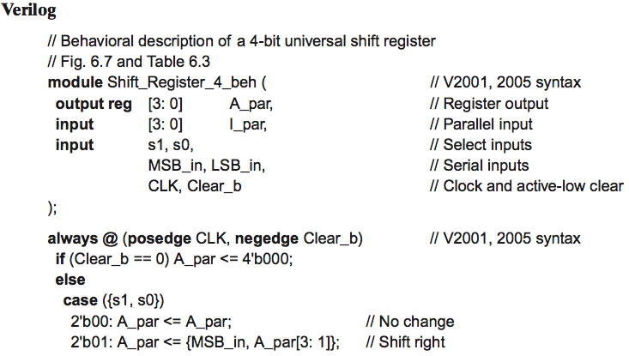
HDL Example 6.1 (Universal Shift Register‐Behavioral Model)

Slide 50
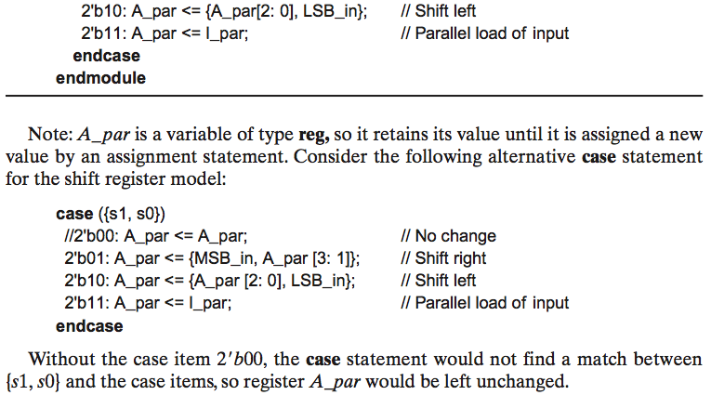
HDL Example 6.1 (Universal Shift Register‐Behavioral Model)

Slide 51
VHDL Example
註：請修改為
buffer
註：請修改為
Clear_b = '0'
註：請修改為
"0000"
註：在這兩行之間新增一行，如下：
elsif CLK'event and CLK = '1' then
註：這四個依序(由上而下)請修改為
when "00"
when "01"
when "10"
when "11"

Slide 52
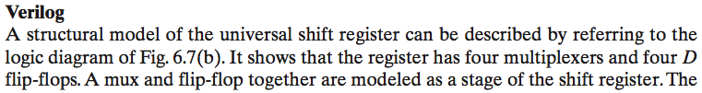
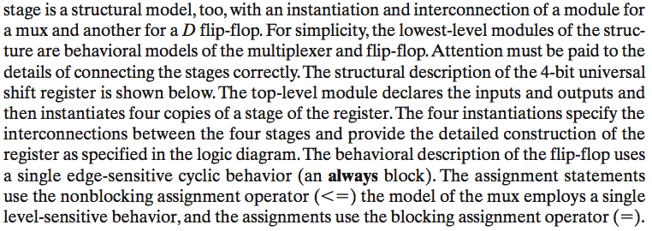
HDL Example 6.2 (Universal Shift Register‐Structural Model)

Slide 53
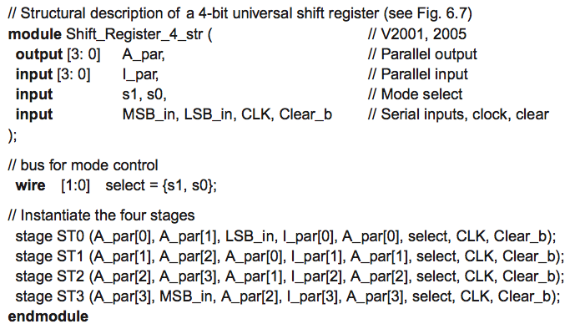
HDL Example 6.2 (Universal Shift Register‐Structural Model)

Slide 54
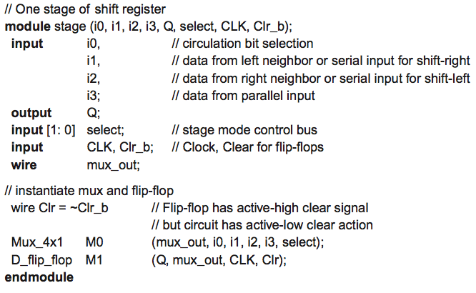
HDL Example 6.2 (Universal Shift Register‐Structural Model)

Slide 55
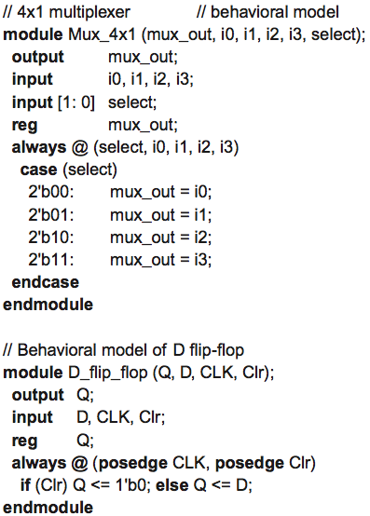
HDL Example 6.2 (Universal Shift Register‐Structural Model)

Slide 56
VHDL Example
註：請修改為
sel
註：請修改為
Std_Logic_Vector
註：請修改為
4×1
註：請修改為
case sel

Slide 57
VHDL Example
註：請修改為
Clr = '1'
註：請修改為
elsif

Slide 58
VHDL Example
註：請修改為
--
註：請修改為
buffer

Slide 59
VHDL Example
註：所有標註的中括號請修改為
小括號，例如：[0] → (0)

Slide 60
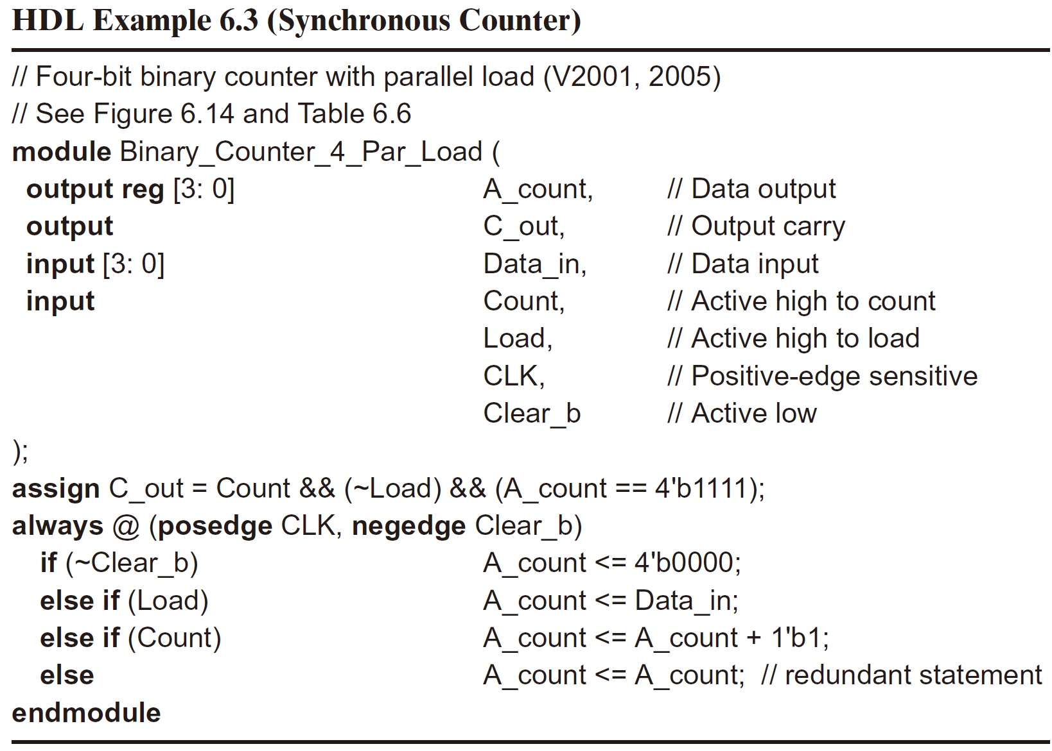
HDL Example 6.3 (Synchronous Counter)

Slide 61
VHDL Example
註：請修改為
buffer
註：請修改為
Load_vhdl is
註：請修改為
Unsigned
註：請修改為
Load_vhdl;
註：請修改為
"1111"
註：請修改為
if Clear_b'event and Clear_b = '0' then A_count <= "0000";
elsif CLK'event and CLK = '1 then
if Load = '1' then A_count <= Data_in;
elsif Count = '1' then A_count <= A_count + "0001";
else A_count <= A_count; -- Redundant statement
end if;

Slide 62
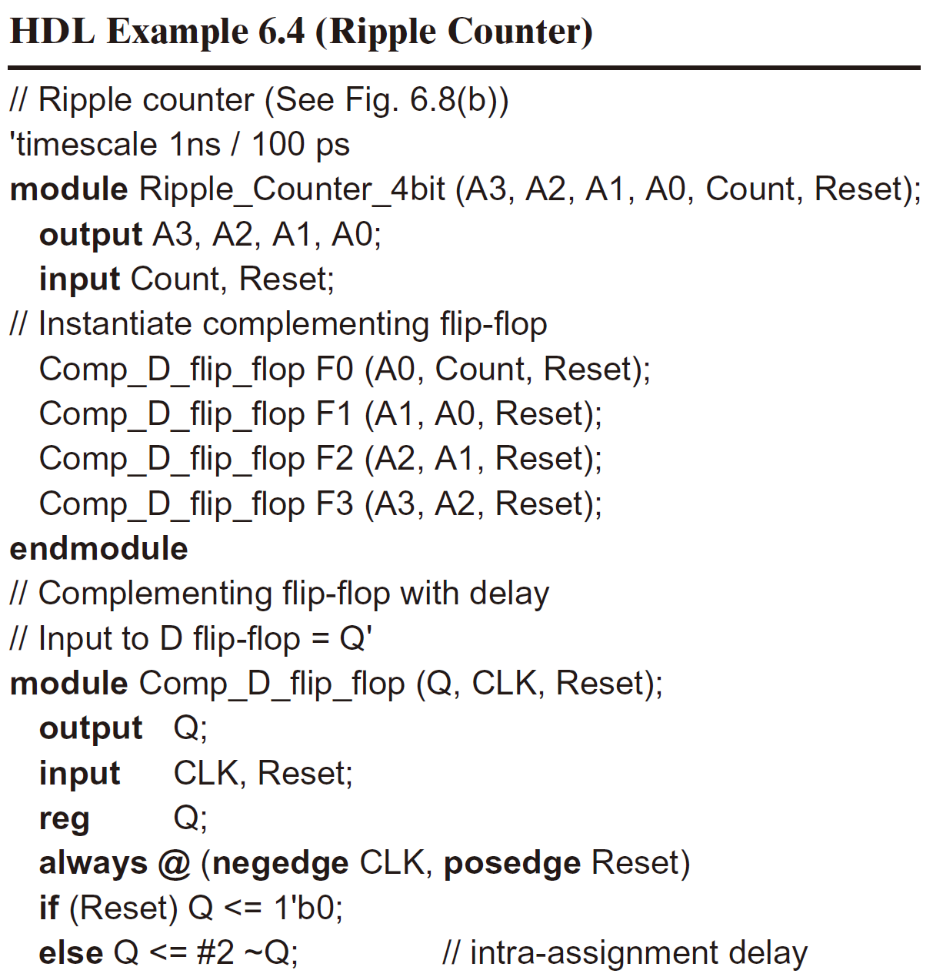
HDL Example 6.4 (Ripple Counter)

Slide 63
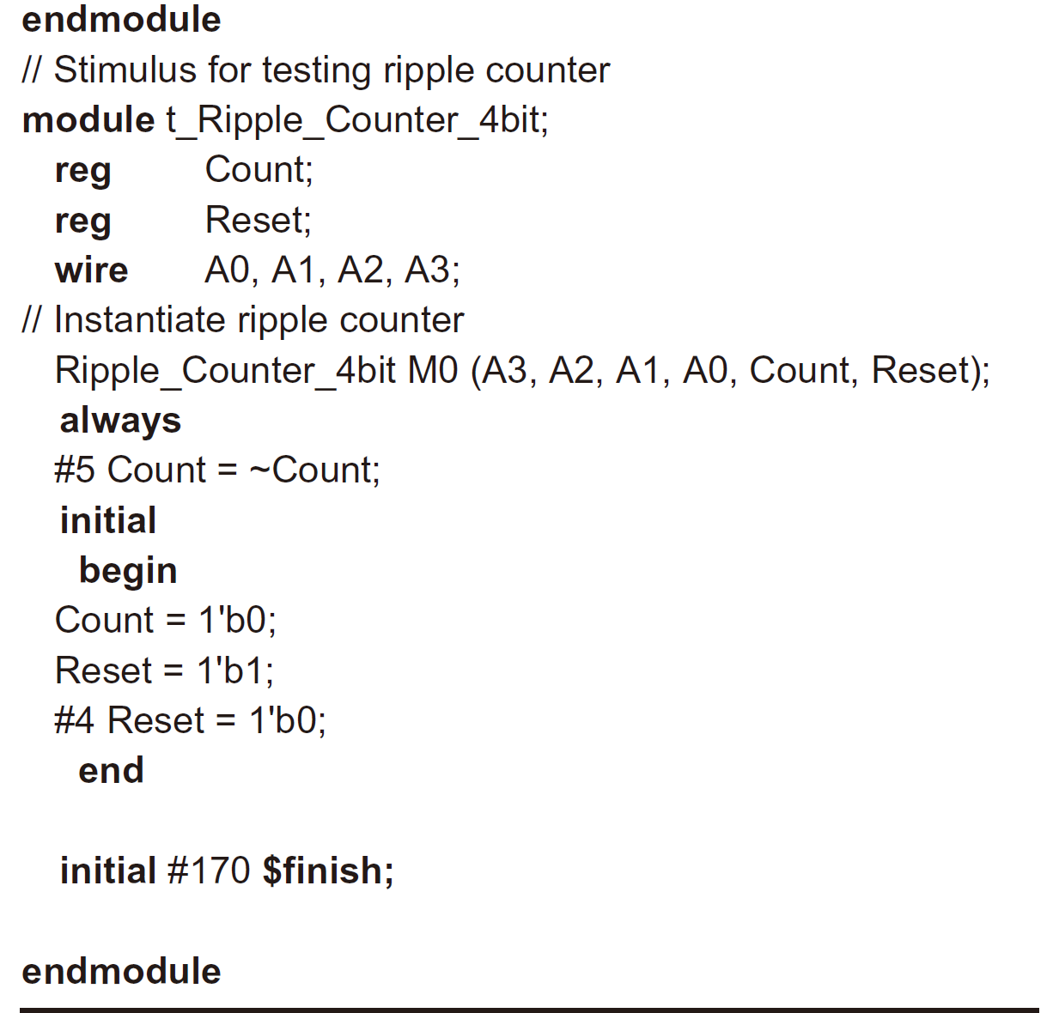
HDL Example 6.4 (cont.)

Slide 64
Practice Exercise
Practice Exercise 6.3 – Verilog
The bits of a four-bit ripple counter are labelled A3, A2, A1, and A0. If the flip-flops of the counter are instantiated and interconnected as shown in the text below, the counter fails to function correctly. Find the error in the code
Comp_D_flip_flop F0 (A0, Count, Reset);
Comp_D_flip_flop F1 (A1, A0, Reset);
Comp_D_flip_flop F2 (A2, A3, Reset);
Comp_D_flip_flop F3 (A3, A1, Reset);
Answer: Flip-flops F2 and F3 are not clocked correctly. In F2, replace A3 by A1. In F3, replace A1 by A2.

Slide 65
VHDL Example
註：請修改為
buffer
註：請修改為
elseif
註：請修改為
endif

Slide 66
VHDL Example
註：請修改為
Logic;

Slide 67
VHDL Example
註：這兩行之間請插入一行
end component;

Slide 68
VHDL Example
註：請修改為
process (); begin
註：請修改為
<= '0'
註：請修改為
<= '1'

Slide 69
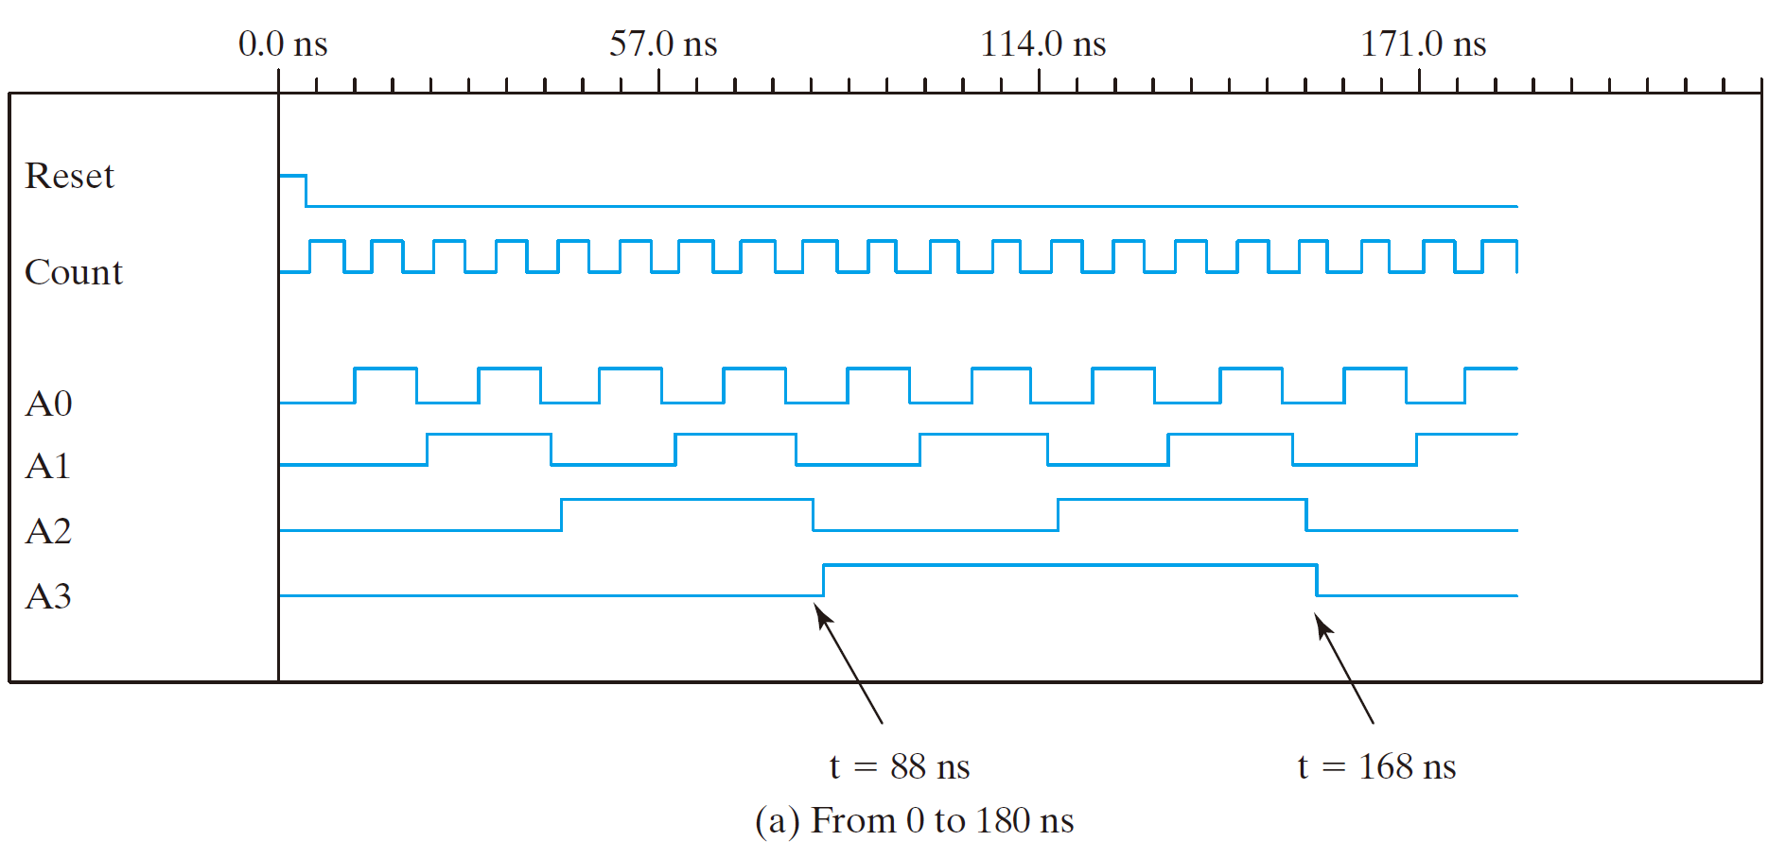
Simulation Output of HDL Example 6.4

Slide 70
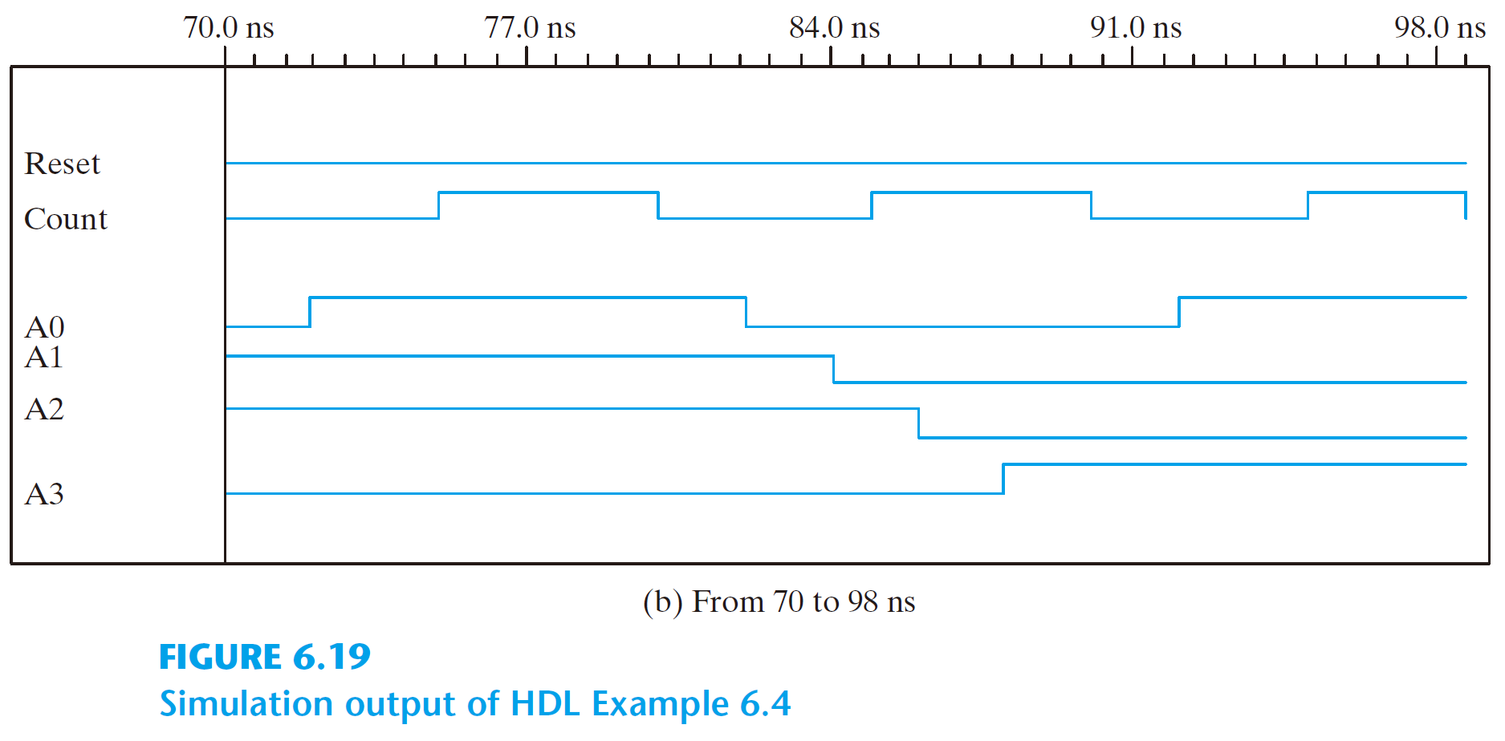
Simulation Output of HDL Example 6.4

Slide 71
Practice Exercise
Practice Exercise 6.3 – VHDL
The bits of a four-bit ripple counter are labeled A3, A2, A1, and A0. If the flip-flops of the counter are instantiated and interconnected as shown below, the counter fails to function correctly. Find the error in the code
F0: Comp_D_flip_flop port map (Q => A0: out CLK => Count, Reset => Reset);
F1: Comp_D_flip_flop port map (Q => A1: out CLK => A0, Reset => Reset);
F2: Comp_D_flip_flop port map (Q => A2: out CLK => A3, Reset => Reset);
F3: Comp_D_flip_flop port map (Q => A3: out CLK => A1, Reset => Reset);
Answer: Flip-flops F2 and F3 are not clocked correctly. In F2, replace A3 by A1. In F3, replace A1 by A2.

Slide 72
Web Search Topics
BCD counter
Johnson counter
Ring counter
Sequence detector
Synchronous counter
Switch-tail ring counter
Up–down counter

